Slide 1
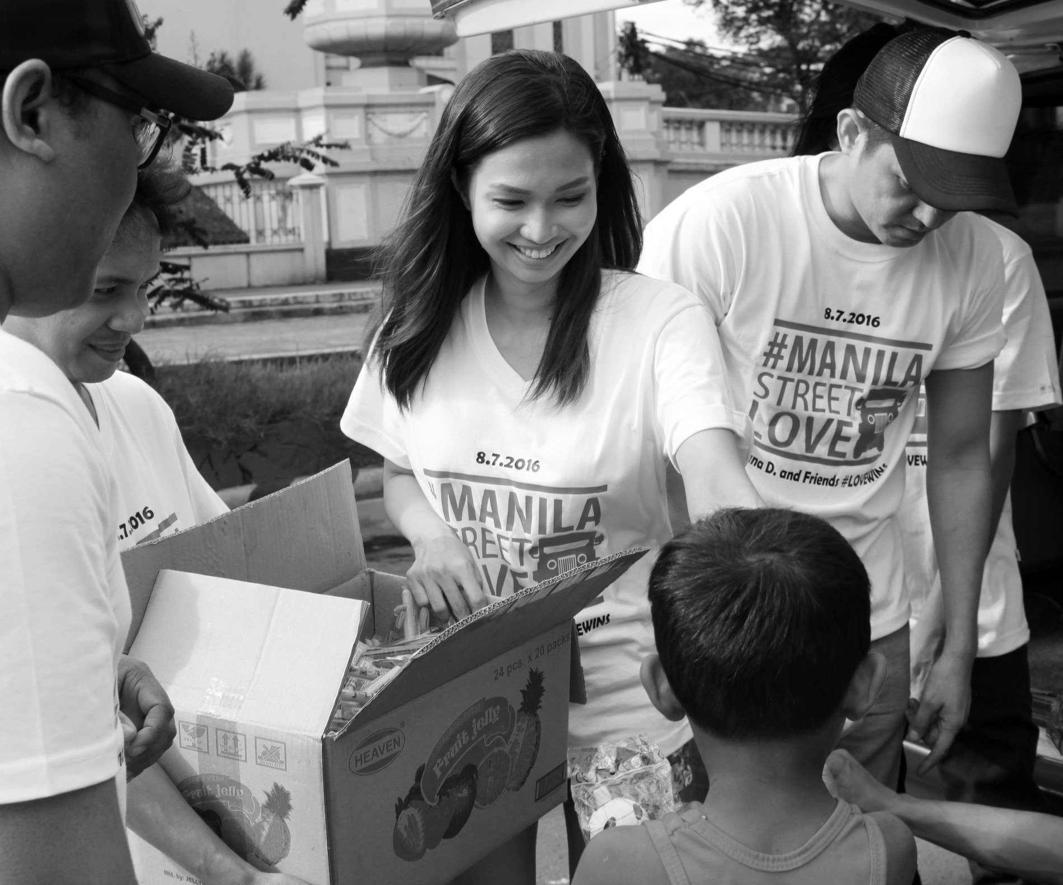
Orange Coding Academy
Full Stack Web Development
Final Project Presentation
clothes house
Done By : Haneen edinat

Slide 2
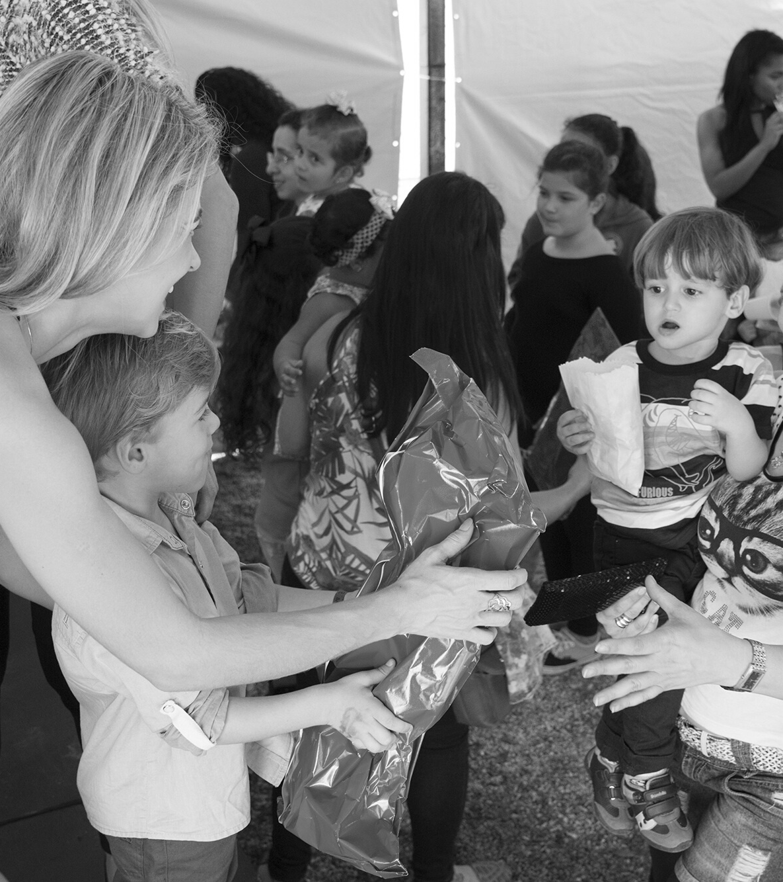
Project Brief
Each donation...New joy!
A project specialized in collecting and recycling surplus clothes and distributing them to the needy.
The idea here, where people can enter the site and make a donation request,
And the person who wants to take these donations can enter and choose among these donations and then
Communicate with him to deliver him to his home.

Slide 3
Problem Statement
In society, many people need some assistance and are working on registering through charities
And when going to receive this aid, it takes a lot of time and effort, in addition to embarrassment.

Slide 4



PROJECT’S Technology

Slide 5
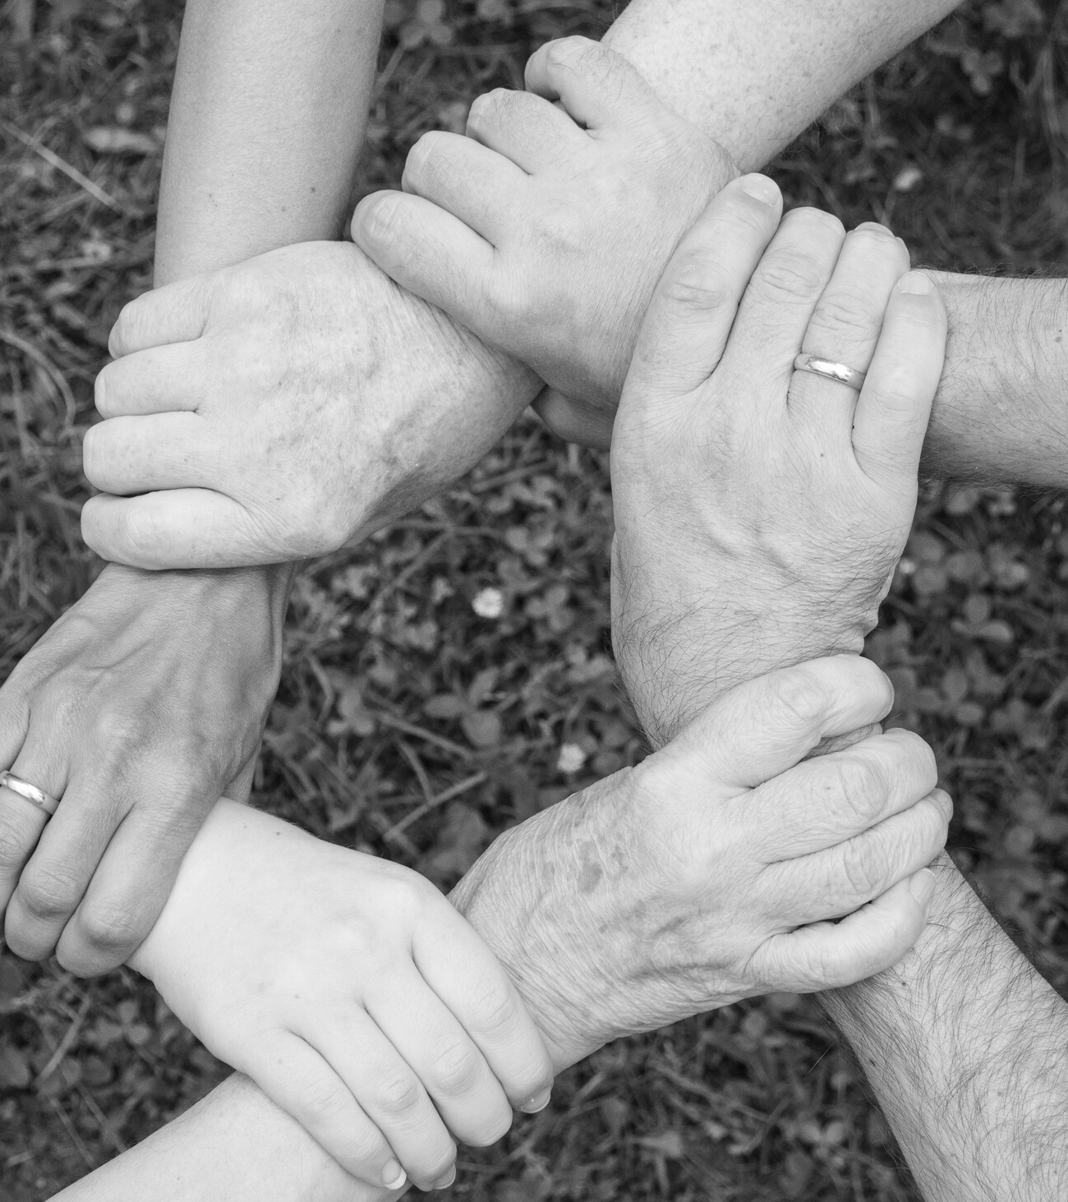
Live Demo

Slide 6
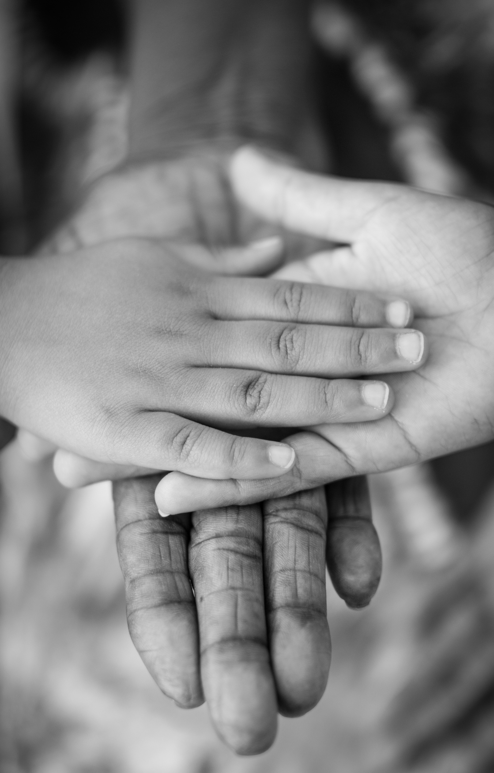
Thank You

